Slide 1

Stamford Shopify Meetup
Thursday, February 1st 2018
Hosted by Chimaera Labs

Slide 2
E-commerce SEO Tactics for 2018
Dale Bertrand, President
Chimaera Labs

Slide 3

Dale Bertrand
Engineering background
Recruited to an MIT start-up to do online marketing
Focus on e-commerce SEO
Run Chimaera Labs
Proud father

Slide 4
Overview
How E-commerce SEO has changed
Organic traffic conversion rates
Tactic #1 – Keyword research
Tactic #2 – Review search results pages
Tactic #3 – Target page titles
Tactic #4 – Craft your search results
Tactic #5 – Content marketing

Slide 5
Background

Slide 6
Why Focus on SEO?
Free traffic (cost effective if not super competitive space)
Targeted traffic that is more likely to buy
89% of consumers begin use search engines to make a purchasing decision
Invest now and reap the benefits for a long time

Slide 7
How E-commerce SEO Has Changed
(In the last several years)
Crowded search results pages
Keyword targeting based on intent
Quality content ranks
Mobile first
Link building schemes don’t work
Helpful platforms (Shopify)

Slide 8
Organic Traffic Conversion Rates
(Desktop)
Home page – 3-4% (mostly branded searches)
Product pages – 1-2%
Collection pages – 0.5%
Blog articles – 0.25%

Slide 9
Types of Keywords
Branded – e.g. “Bre’s Boutique”
Branded product – e.g. “Mom’s Life Sweater”
Specific product – e.g. “Tie-Dye Tank Top”
Generic product – e.g. “Sweaters”
Specific collection – e.g. “Gifts for Women”
Informational – e.g. “What to wear a winter wedding”

Slide 10
Tactics

Slide 11
Tactic #1 - Keyword Research
Identify the keywords people use to find your products
Learn to speak their language
Choose relevant keywords with high search volume
Optimize product and collection pages

Slide 12
Keyword Research Tools
Keyword Planner
Search Console
Paid tools: SEMRush, KeywordSpy, Ahrefs, Moz

Slide 13
Tactic #2 - Review Search Results Pages
Type your keywords into Google (Simple!)
What type of search results appear?
Shopping ads, text ads, web results, images, videos, local listings

Slide 14
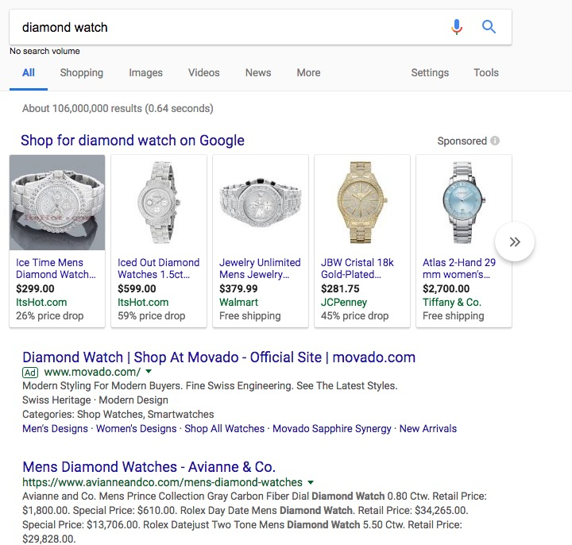

Slide 15
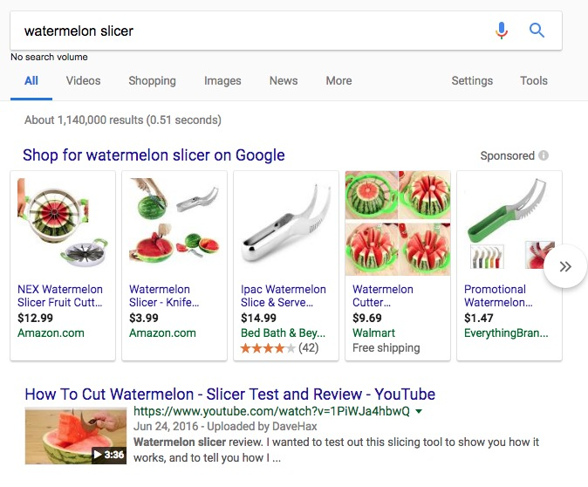

Slide 16
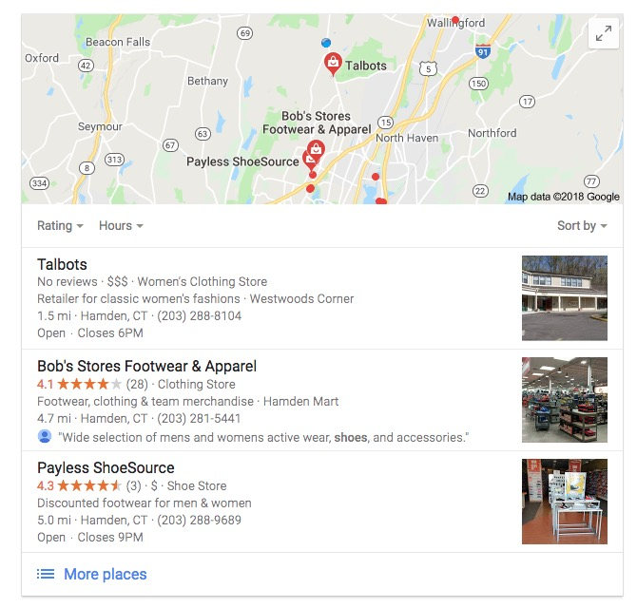

Slide 17
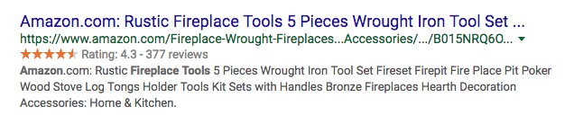

Tactic #3 – Target Page Titles

Slide 18
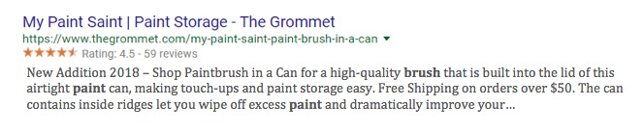
Tactic #4 – Craft Your Search Results

Slide 19
Tactic #5 – Content Marketing
Content Development
Buying guides
Gift collections
Reviews
Comparison
Sizing guides
Blog articles
Video
Content Promotion
Partnerships
Influencers
Gift guides
Social media
Podcast
Blog
Email marketing

Slide 20
Stay in touch
dale@chimaeralabs.com
www.chimaeralabs.com

