Slide 1
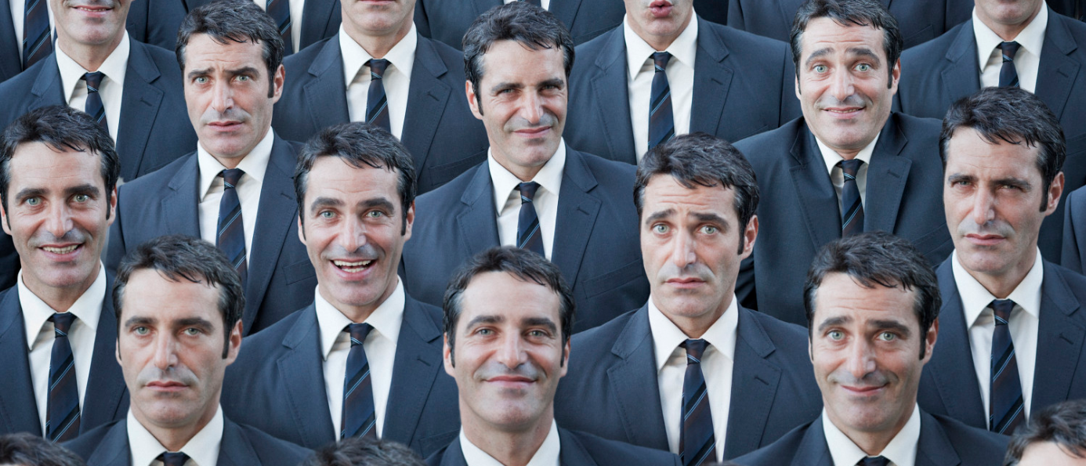
Attack of the Clones

Slide 2
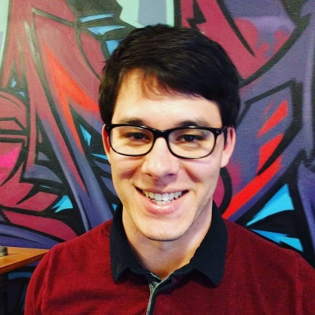
3 Random Facts About Me:

Slide 3
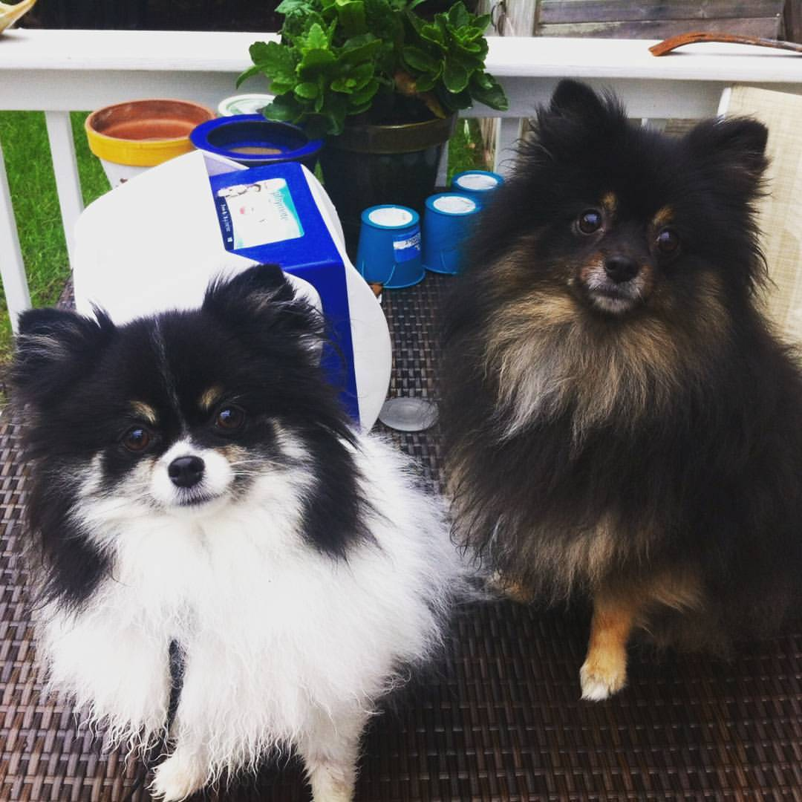
I Love Pomeranians
Tutu
Pippa

Slide 4
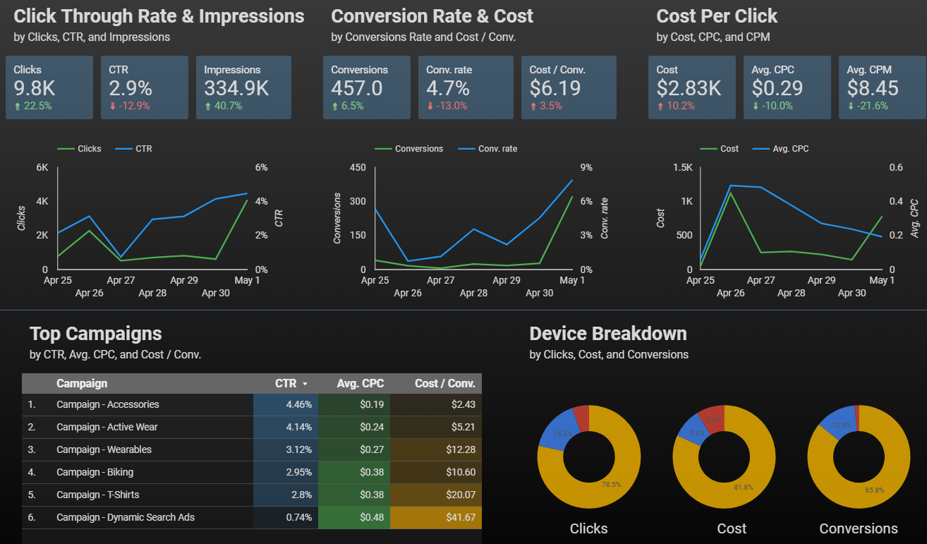
I Also Love Data

Slide 5
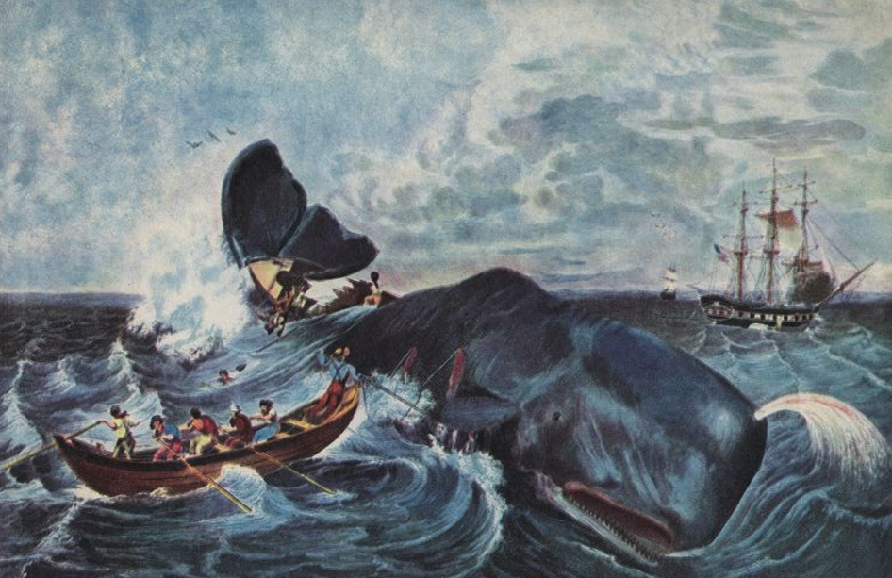
I am Originally from Cape Cod

Slide 6
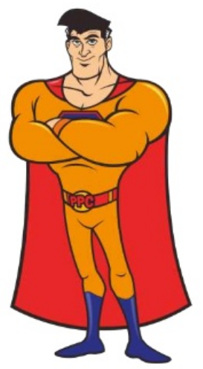
Agenda: How Lookalike Audiences Will Save the Day
What are Lookalike Audiences
How they Work
How you can use Lookalikes Today
My Top 3 Actionable Lookalike Tips!!

Slide 7
What Are Lookalike Audiences?

Slide 8
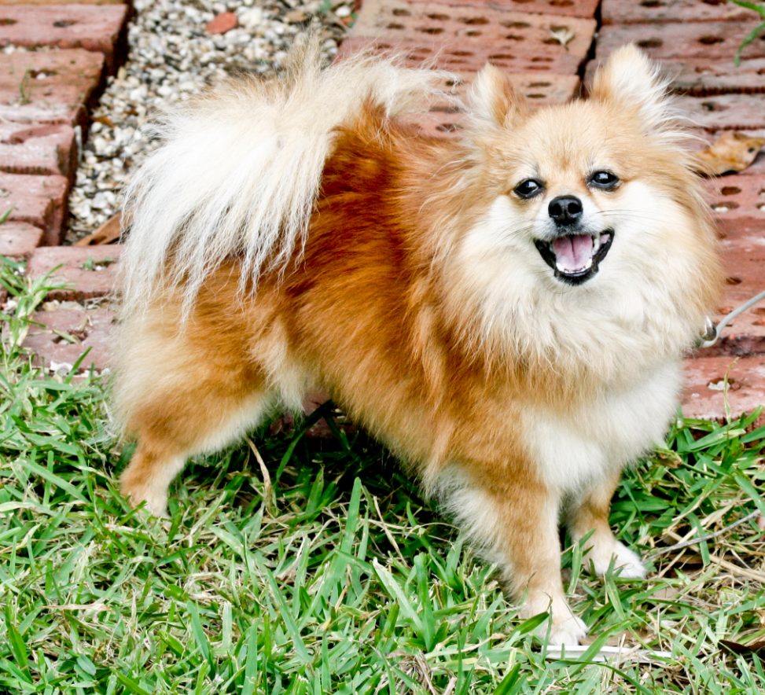
Your Perfect Customer
(Hopefully not actually a dog)

Slide 9
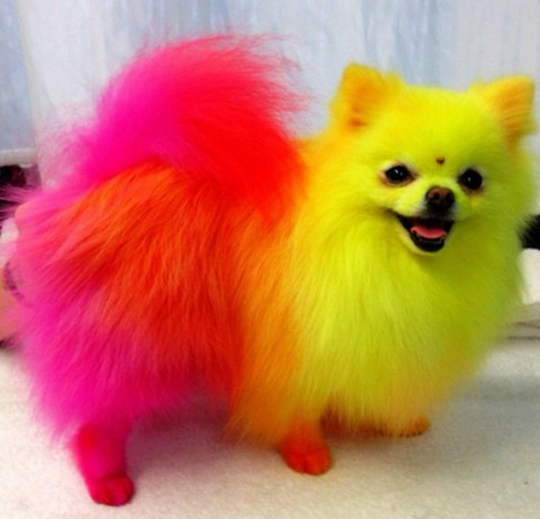
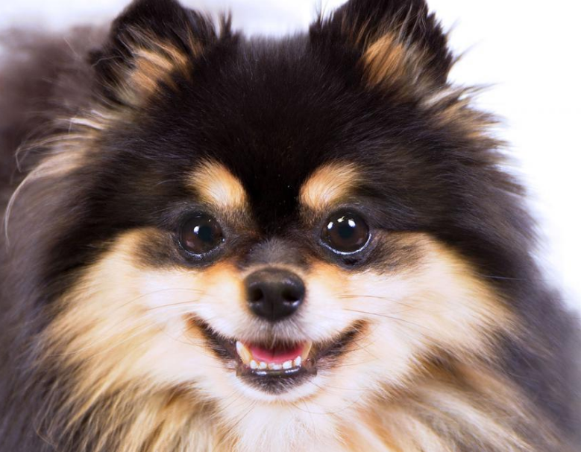
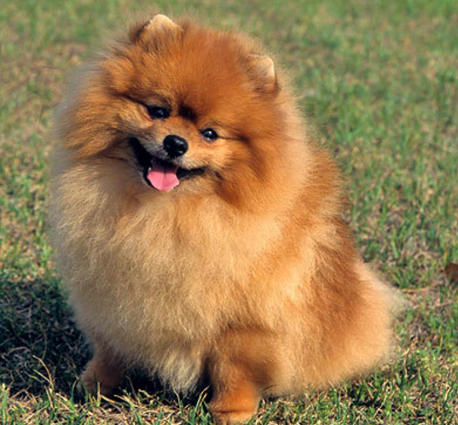
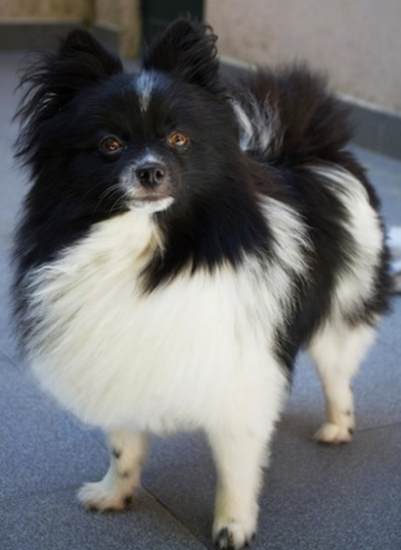
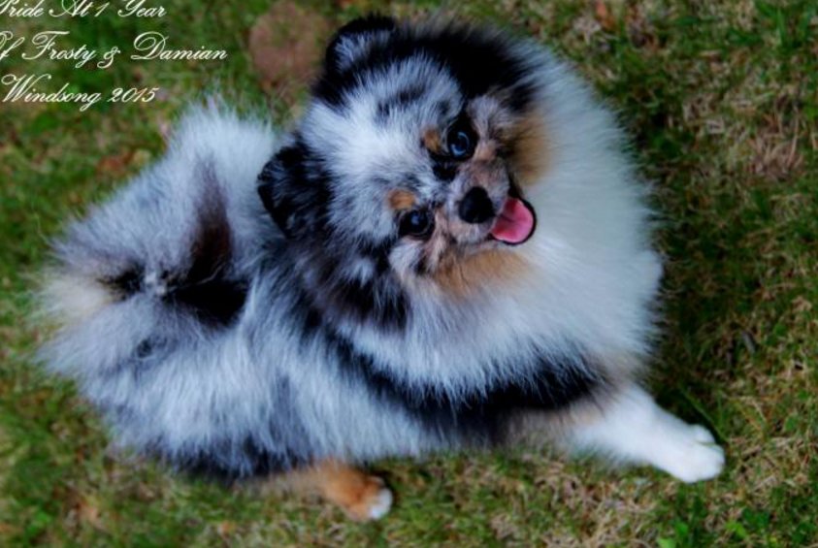
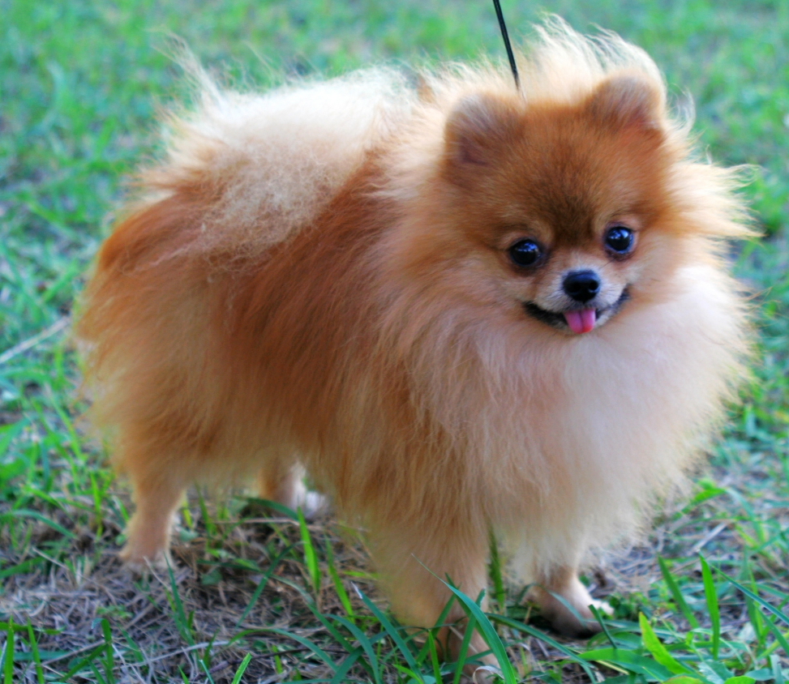
Your Current Customer List
Segment
Segment

Slide 10
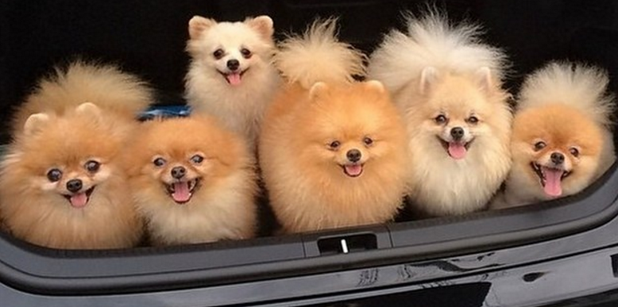
Current Customers
Audience of Perfect Future Customers
“Secret Facebook Algorithm”

Slide 11
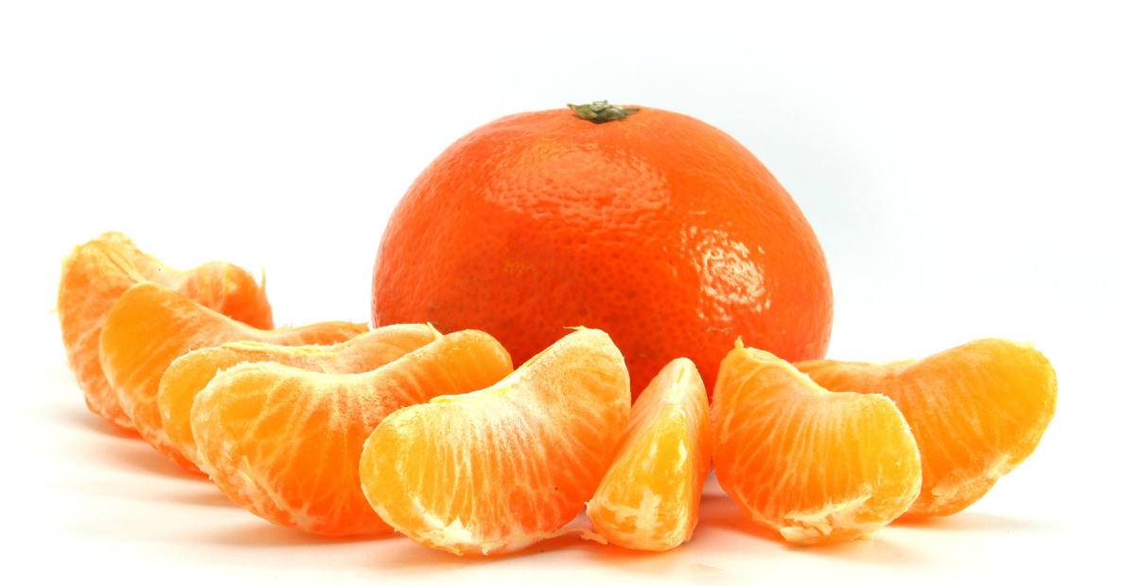
Super Secret Lookalike Tip #1
Start large. Segment AGGRESSIVELY.

Slide 12
How do they Work?

Slide 13
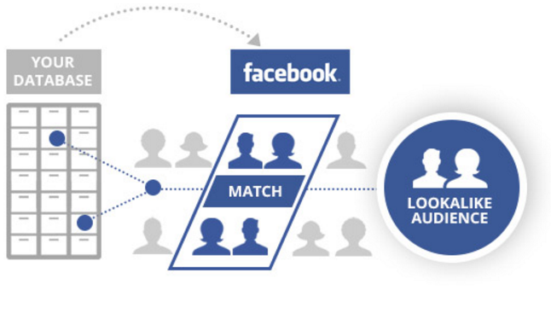
What Facebook Tells You Happens

Slide 14
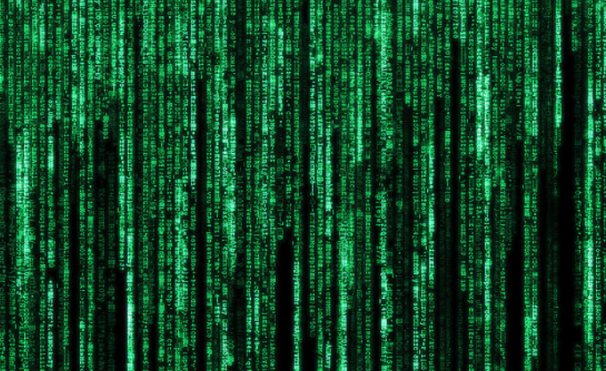
What Actually Happens

Slide 15
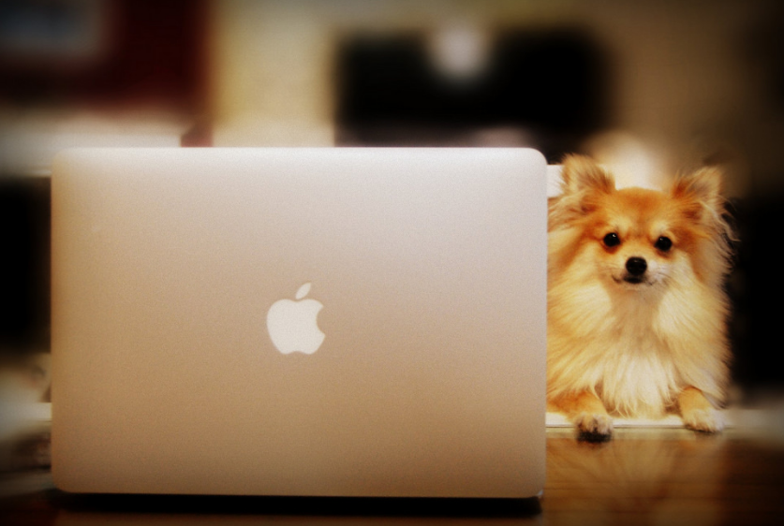
User Volunteered Data is your Friend

Slide 16
How can I use Lookalike Audiences?

Slide 17
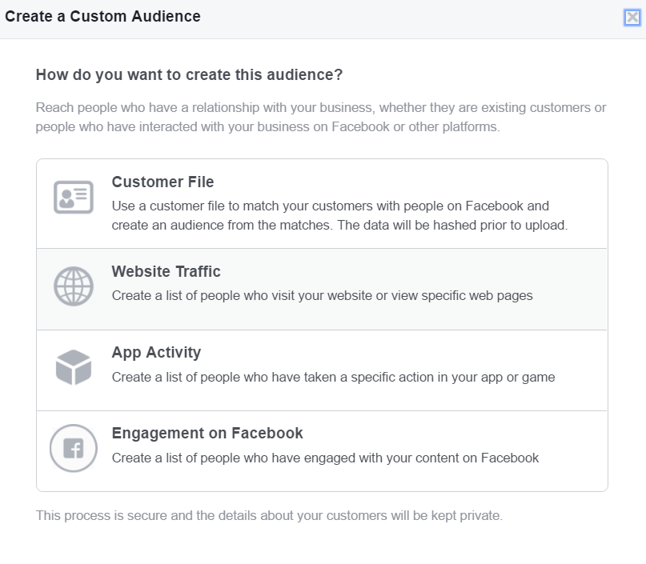
Load in an Audience

Slide 18
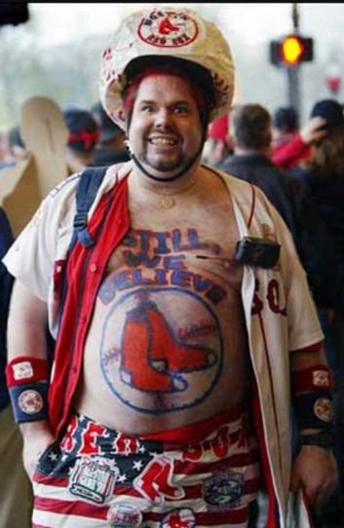
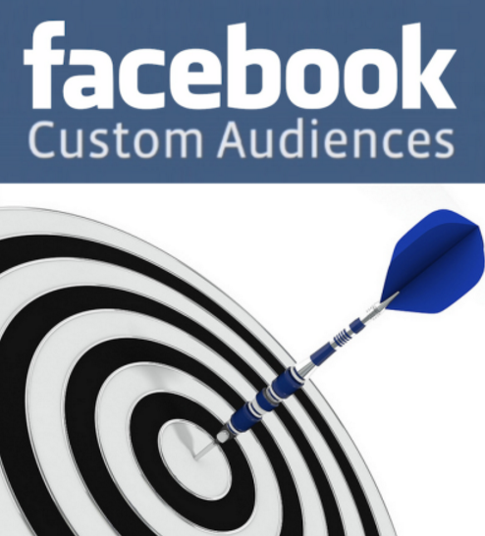
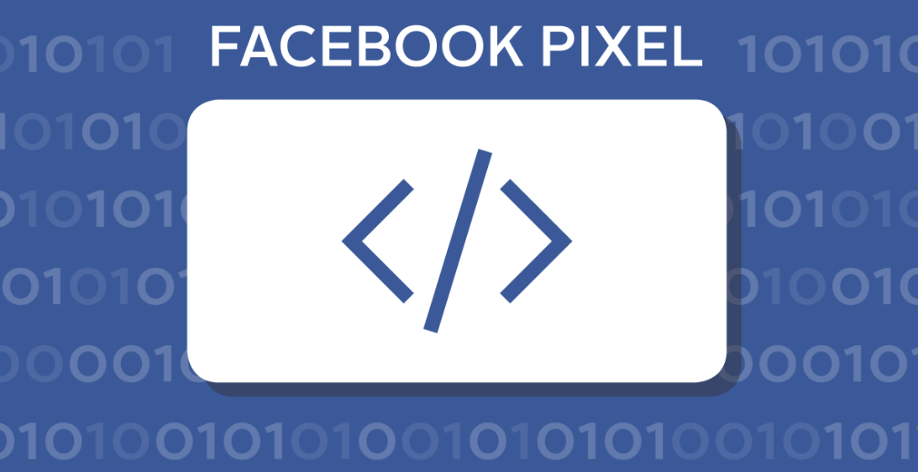
Your Lookalike Targeting Weapons
Custom Audiences
Website Visitors
Page Fans

Slide 19
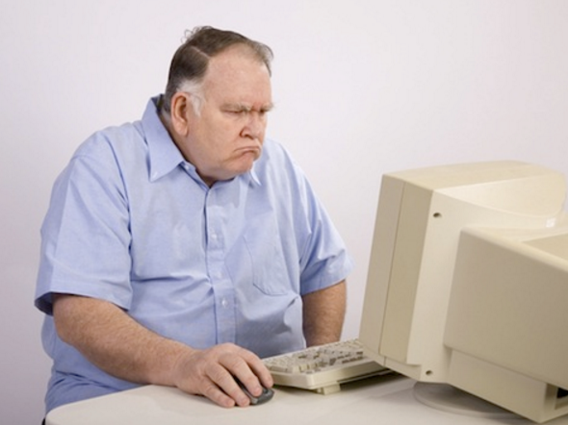
Wait, Aren't these Just my Current Customers?

Slide 20
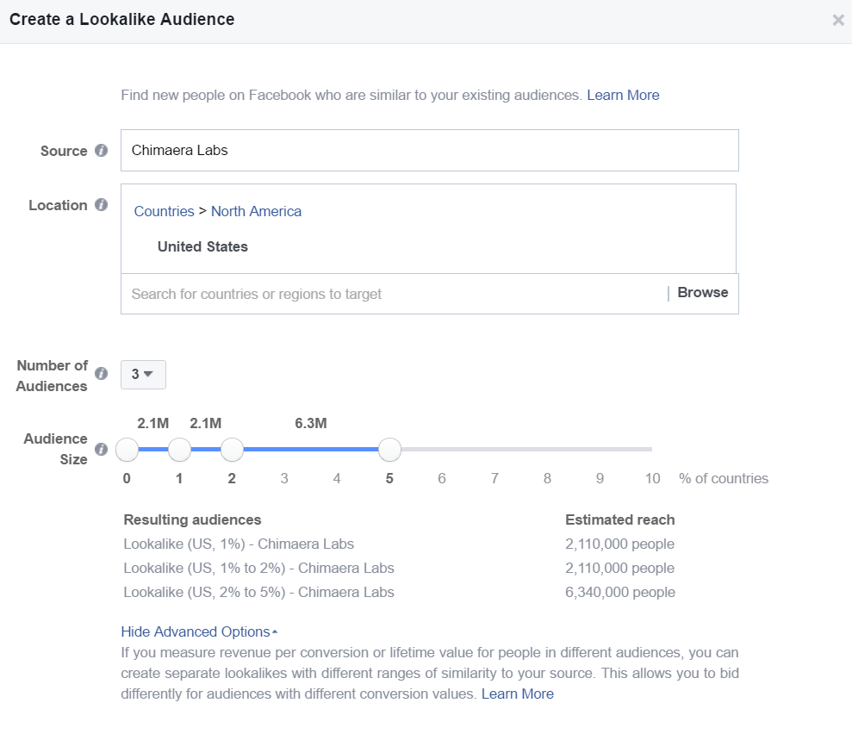
Sculpt a Lookalike

Slide 21
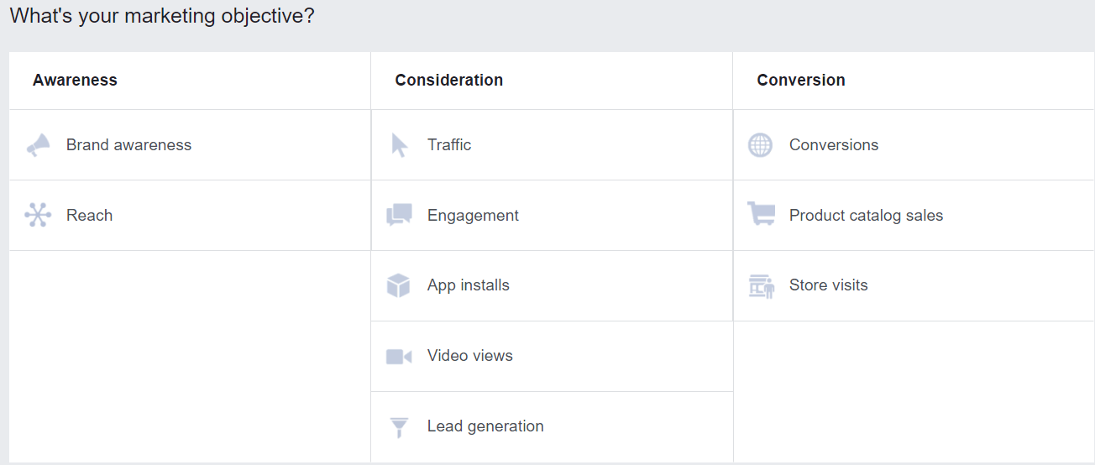
Choose an Objective

Slide 22
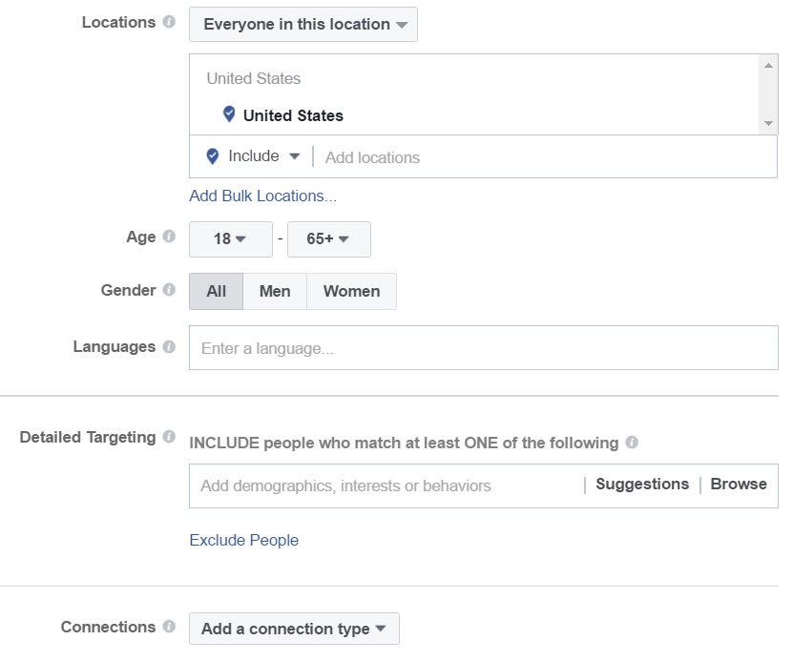
Additional Targeting

Slide 23
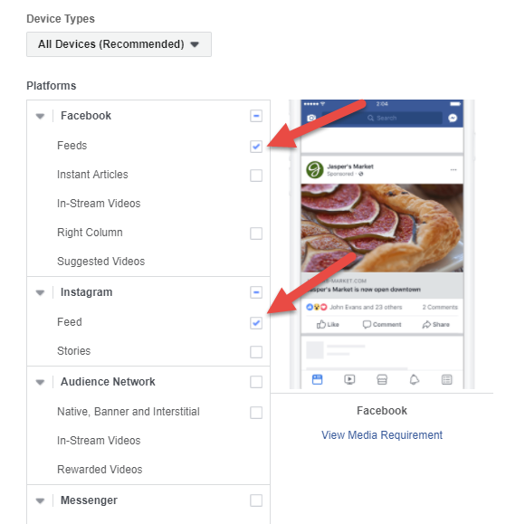
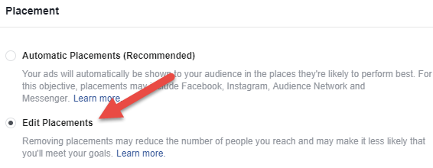
Be Mindful of Traps

Slide 24
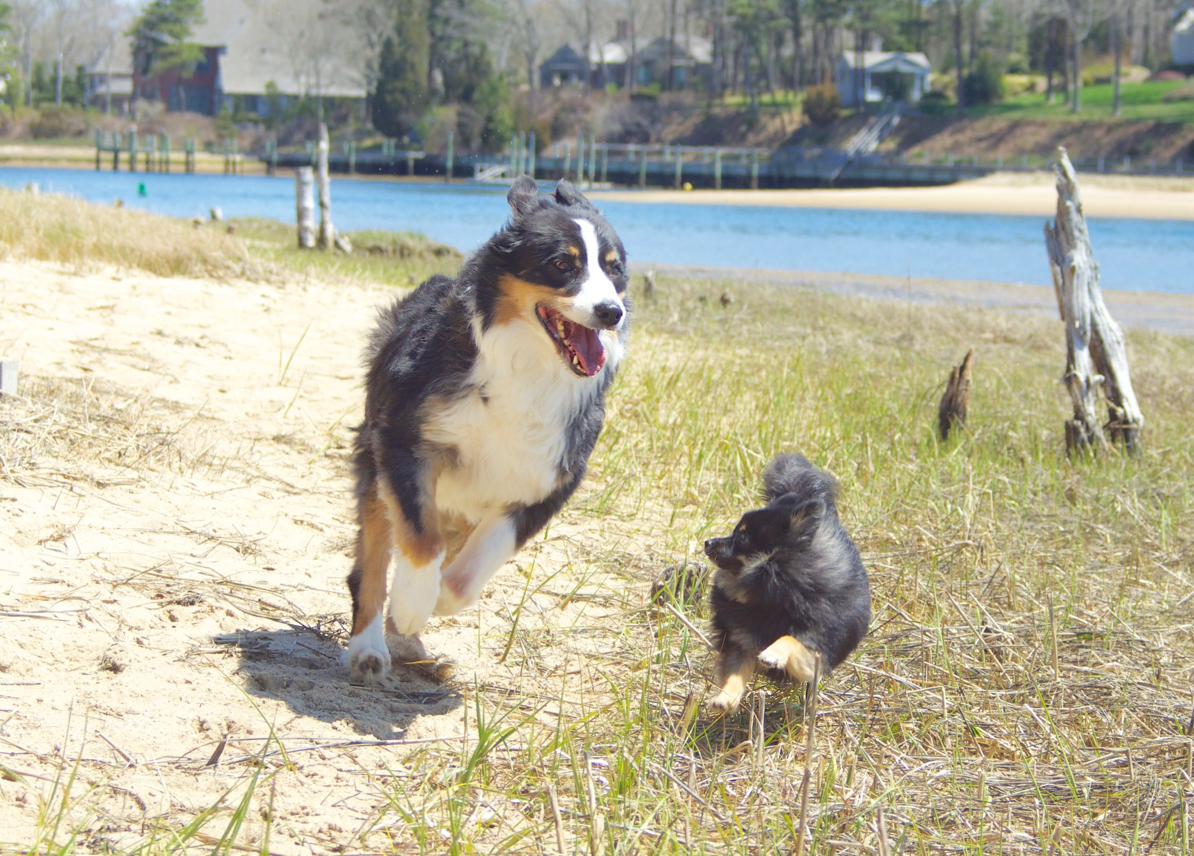
Dog Break

Slide 25
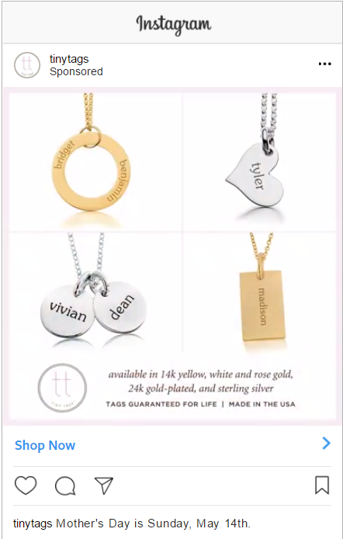
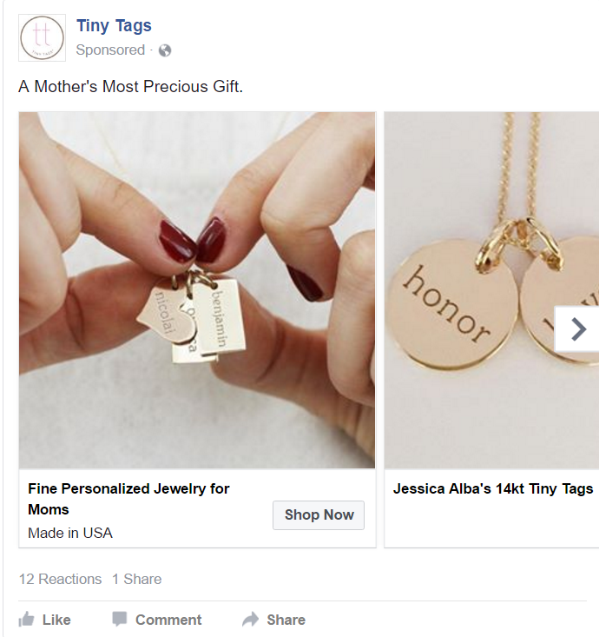
Create Your Ads

Slide 26
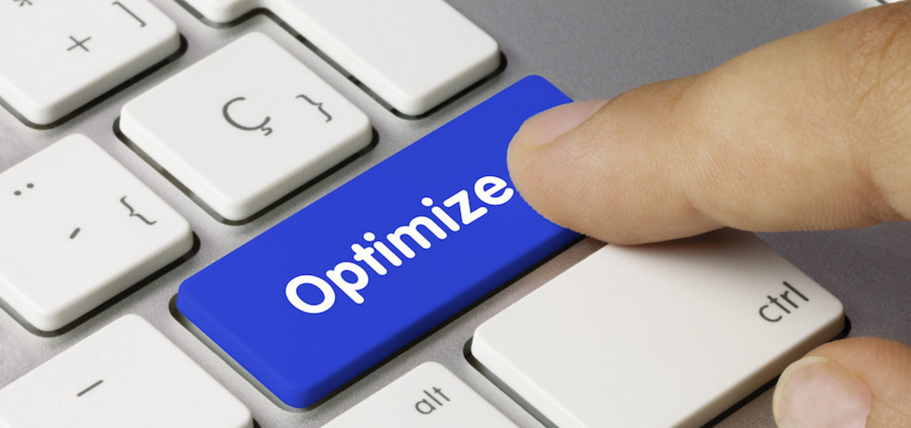
Optimize!

Slide 27
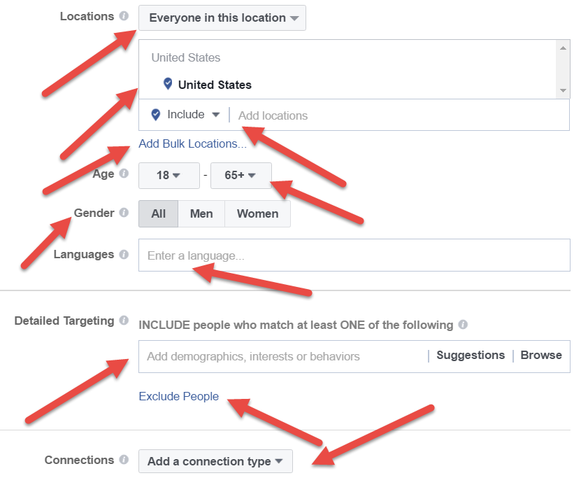
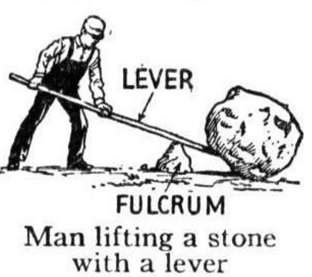
Super Secret Lookalike Tip #2
Test EVERYTHING!

Slide 28
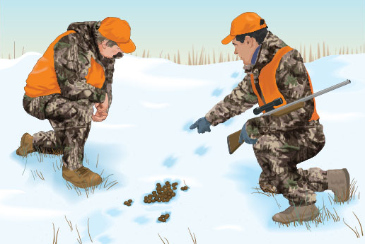
The Importance of Tracking

Slide 29
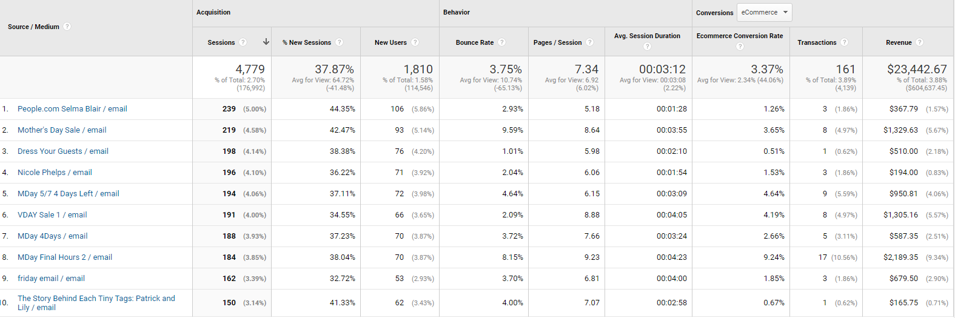
ULTIMATE TRACKING
thehousecar.com?utm_source=email&utm_medium=Johannas%20List&utm_campaign=Concierges%20first%20effort&utm_term=jan24%20to%20jan27

Slide 30
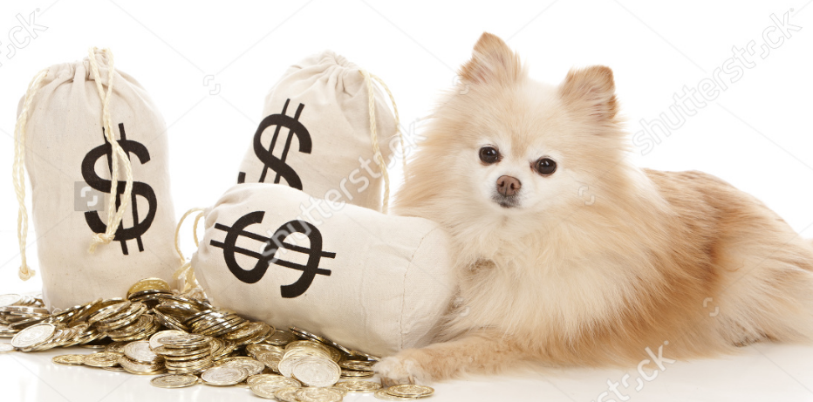
Super Secret Lookalike Tip #3
Scale to the MAX!

Slide 31
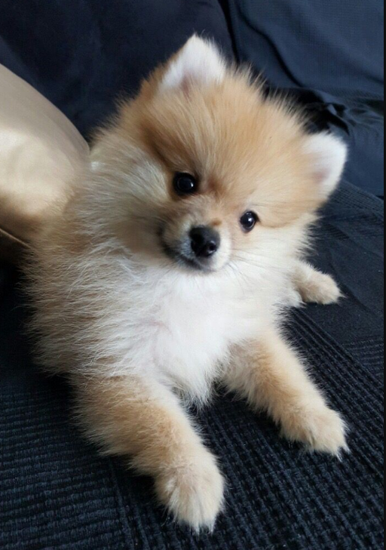
Questions?

